Slide 1

WELCOME
TO
PUBLIC SCHOOL KHAROD

Slide 2
PUBLIC SCHOOL KHAROD
Affiliation No. 430116
School Code No. 13090
National Highway No.8, Opp. Kharod Village
Ta. Ankleshwar, Dist. Bharuch, (Gujarat) - 394 115
Contact: Tel. No. (O) 02646- 276500, 651599
School Mob. No. 9227828729
Email: publicschoolkharod@gmail.com
Website: www.publicschoolkharod.com

Slide 3
NEW EDUCATION POLICY OF CBSE
ORIENTATION PROGRAMME

Slide 4


OLD PATTERN’S DRAWBACKS
Not prepared , no problem
Projects will get me marks
No detention policy, Automatic promotion to next class

Slide 5


END OF CCE
A new education policy with no semester system
THEN WHATS
NEW ? ………

Slide 6
Why not? let me explain its features..
Can you explain its features ?

Slide 7

WELCOME TO NEW EDUCATION POLICY SESSION 2017-18

Slide 8
SUBJECTS OFFERED FOR CLASS I TO V
HINDI
MATHS
ENGLISH
EVS
I.T

Slide 9
SUBJECT OFFERED FOR CLASS VI TO VIII
ENGLISH
SANSKRIT
SCIENCE
I.T
HINDI
MATHS
S.S

Slide 10
SUBJECTS OFFRED (IX&X)
5 COMPULSORY SUBJECTS
1 COMPULSORY VOCATIONAL SUBJECT
FIT (FOUNDATION OF I.T)
ENGLISH COMMUNICATIVE
HINDI
COURSE - B
MATHEMATICS
SCIENCE
SOCIAL SCIENCE

Slide 11
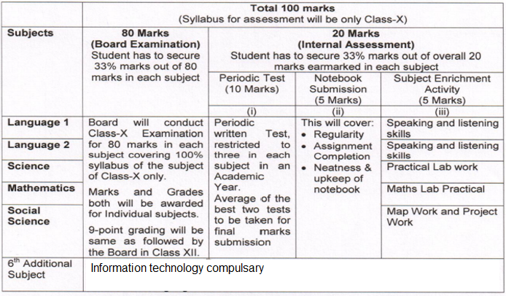
LETS SEE THE PROVISIONS OF NEW EDUCATION POLICY

Slide 13
EXAM SYSTEM
PRE-MID TERM
MID-TERM
POST-MID TERM
ANNUAL EXAM

Slide 14
SYLLABUS DISTRIBUTION FOR FINAL EVALUATION
1.Class I to III :- Syllabus covered during July to February.
2.Class IV to V :- 100% of the syllabus.
Objective type of questions from the syllabus covered during April to July.
All type of questions from the syllabus covered during July to February.
3.Class VI to X:- 100% of the syllabus covered during April to February.

Slide 15
IMPORTANT INFORMATION
PRE-MID TERM EXAM:
Syllabus included - 25%
Maximum marks - 50.
Passing marks - 17 (33%)
MID-TERM EXAM:
Syllabus included - 50%
Maximum marks - 50.
Passing marks - 17 (33%)

Slide 16
POST-MID TERM:
Syllabus covered - 75%.
Maximum marks - 50.
Passing marks – 17 (33%)
FINAL EXAM :
Syllabus covered - 100 %
Maximum marks - 80.
Passing marks - 27 (33%)

Slide 17
WEIGHTAGE OF TERM EXAM & FINAL EXAM
Final exam :- weightage 80%.
Periodic test 3 :-weightage 10%.
  Best two assessment out of 3 periodic tests will be added and converted in to 10.
  Term exam will cover the weightage of 10% for final evaluation

Slide 18
Note book maintenance – 5%
Before each periodic test , note book maintenance can be evaluated based on following parameters….
Regularity.
Assignment completion.
Neatness and upkeep of notebooks average of 3 assessment will be converted in to 5 marks for aggregating.

Slide 19
SUBJECT ENRICHMENT ACTIVITIES - 5%
Subject enrichment activities comprise of various techniques like ASL/reading/ dictation/ debate/ public speaking for language.
Lab activity/ projects/ mapwork/ field trips etc. For other subjects which can be conducted three times before each periodic test and average marks may be converted out of 5 .

Slide 20
PRE-MID TERM 25%
SYLLABUS FOR EXAM
MID-TERM
50%
POST-MID TERM 75%
FINAL EXAM 100%

Slide 21
OUR RESPONSIBILITIES

Slide 22
Parents

Slide 23
Ask students to abide strictly by the time table.
Encourage the students to re- pack their bags on daily basis to avoid carrying un necessary articles , text books, work books that are not needed.
All the task related to projects , activities, assignments are suppose to conduct as class activity under the supervision of subject teacher. It should not be prescribed as Homework. If your ward informs you so, please conform with us.
Parents are requested to separate the text book up to the syllabus of mid term, if you wish to reduce the load of school bag.

Slide 24
Parents are suppose to file all the work sheets provided to their wards by respective subject teacher and Maintain separate file for the different subjects.
For the students of I & II parents are requested to sent only pencil box, water bottle, school diary & napkins(handkerchief).
PSK is supplying adequate portable and safe drinking water so no need to bring heavy water bottle to school.

Slide 25
For any of the science experiments you can be asked to bring few things related to experiment so please co-operate with us to make the required things available.
In place of cartoon or other entertainment channels encourage your ward to watch educational channels like History channel 18, National Geography, Science of Stupids
Don’t allow your ward to spend time with mobile phones and Internet. Parents are requested to spare some quality time with them to find their inherent qualities.
Develop reading habits in them because ones it will develop in childhood will continue and helpful till higher studies and entire life.

Slide 26
Portfolio
Parents are requested to maintain the portfolio of their ward, best portfolio will be awarded at the end of the academic session.
Portfolio includes:- Any extra ordinary creative work of child done at home or school, any write-up about special incident when your child behave beyond your expectation, write up about their area of interest may be Music, drawing, singing, acting, you are advised to put photographs for the same.
Write-up about characteristic of the child.

Slide 27
Teachers

Slide 28
Teachers should check school bags randomly to ensure the proper weight of school bags .
All the task related to projects , activities, assignments are suppose to conduct as class activity under the supervision of subject teacher. It should not be prescribed as Homework.
No assignment will be given as Homework to the student of class I and II.
Teacher should adopt some such type of alternative method of teaching to alleviate the dependence of textbook and enhance the interest of student.

Slide 29
Teacher should encourage all the students to use loose sheets as work book.
For I & II std students, teachers will send the weekly worksheets at home and no Home work will be given .
Teachers will prepare practical, demonstration and experiment based PPT to replace traditional lecture based classes into interesting ones and to seek the attention of the student.

Slide 30
Teachers will inform about the requirements at least 2 days before to the parents by written information in diaries.
Teachers will take care about the reading habit of the student.
Teachers has to guide the parents about the port-folio.

Slide 31
Management

Slide 32
Management is providing some more digital classes.
SMS facility for frequent interaction with parents.
Management will be providing soon new buses with GPS facility.
Facility of language lab to develop the command on English language.
New Jr. Science and Maths lab to young minds for exploring scientific and mathematical facts.
To explore the World, facility of S.S. lab will also be provided from this session onwards.

Slide 33
EXPECTATIONS
FROM
PARENTS & STUDENTS

Slide 34
PLEASE PAY ATTENTION
No leave will be sanctioned during any of the exam.
In case of medical leave , parents are requested to report to the principal personally along with an application and a medical certificate.
No half day leave is permitted without any genuine reason.

Slide 35
1. STUDENT’S DIARY
It is a comprehensive document of the school.
Parents must read all the details given in the diary.
Students must carry it to school everyday.
Parents have to provide all personal data mentioned in the diary as per the school records at the time of admission.
All notes given by the teachers should be checked & signed by the parents every day without fail.
Parents should be very careful in providing the details which are required by the CBSE.

Slide 36
2. REGULARITY AND PUNCTUALITY
Child must reach school at least 7.30 am
75% attendance is mandatory as per CBSE rules.
If there is a genuine requirement, his / her absence must be supported by a leave application ,preferably through school diary.

Slide 37



Slide 38
THANK YOU
To know more please visit this website: cbse.nic.in.

